Slide 1
LoRa Project Update
Done by:
Yashiv Fakir

Slide 2
Initial Project Specifications
Project Outline
Aspects Required to be Met
Utilize pre built LoRa modules to develop a communication method for radiosonde data, for weather balloon applications. This is to be done between the modules. Overall, to establish if the protocol can be used for this application.
Beginning with land tests and ending with a balloon test.
- Bandwidth: 1200 – 4800 bps
- Range: 100 km
- Altitude: 35 – 38 km
- Temperature: Environment temp = -90 C
- Explore effect of balloon tracking
- Explore effect data compression algorithms

Slide 3
Current Project Specifications
Project Outline
Aspects being met
Similar to initial specifications excluding the effect of temperature and an actual weather balloon test.
The main focus shifted to optimizing the LoRa parameters to maximise range as quickly established that LoRa can be used for this application already.
- Bandwidth: 1200 – 4800 bps
- Range: 1.2 km (but can be propagated to get theoretical max distance
- Altitude: +- 100 m (Wind preventing max height)
- Drone tracking from ground
- Data compression using real data

Slide 4
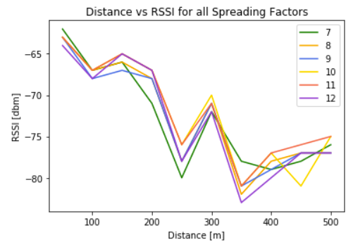
Project Components that are Completed
Parameters for the protocol have been tested and results taken for:
BW, Carrier Frequency, Spreading Factor, Coding Rate
Output in terms of RSSI values showing success for smaller BW and carrier frequency. The spreading factor however is not reflecting a clear winner shown to the right.
Have established optimal LoRa parameters with the exception of SF
Have acquired some real life radiosonde data and begun exploring compression/encoding methods

Slide 5
Project Components that are Completed Continued
Both LoRa modules of 433 MHz and 868 MHz have been coded and work
The GPS module required for the stand is coded (but cannot calculate elevation)

Slide 6
Project Components that still need to be Completed
Tasks that still need to be done:
Explore and code data compression algorithms
Perform a range test with compressed radiosonde data
Perform a mountain to mountain long range test
Perform a drone tracking test using the stand
Stand is almost complete and can be printed, just waiting for the dimensions of the motors to model a socket for the motors
Develop code to govern the two stepper motors
Continue writing the report

